Slide 1
Optimizing Information Leakage in Multi-cloud Storage Services
Batch:MP20CS09 Under the guidance of Project Coordinator
B. Raman (160716733031) Mr K. Uday Kumar, Mr. Sandeep R ,
B. Nandu (160716733032) Assistant Professor, Assistant Professor,
K. Gautham (160716733045) Department of CSE Department of CSE

Slide 2
ABSTRACT
Distributing data over different cloud storage providers automatically provides users with a certain degree of information leakage control, for no single point of attack can leak all the information.
Unplanned distribution of data chunks can lead to high information disclosure even while using multiple clouds. We study an important information leakage problem caused by unplanned data distribution in multicloud storage services.
StoreSim is an information leakage aware storage system in multicloud. StoreSim aims to store syntactically similar data on the same cloud, thus minimizing the user’s information leakage across multiple clouds.
We design an approximate algorithm to efficiently generate similarity-preserving signatures for data chunks based on MinHash and Bloom filter, and also design a function to compute the information leakage based on these signatures.

Slide 3
CONTENTS
Introduction
Literature Survey
Existing System
Proposed System
Simple Project Flow
Full Stack Technology
References

Slide 4
Introduction
Centralized cloud storage services are criticized for grabbing the control of users data, which allows storage providers to run analytics for marketing and advertising.
Also the information in users data can be leaked. In our project the possible solution to reduce the risk of information leakage is to employ multicloud storage systems in which no single point of attack can leak all the information.

Slide 5
Literature Survey
Existing System
DepSky : Dependable and Secure Storage in a Cloud-of-Clouds
DepSky a system that improves the availability, integrity, and confidentiality of information stored in the cloud through the encryption, encoding, and replication of the data on diverse clouds that form a cloud-of-clouds.
The monetary costs of using DepSky in this scenario is at most twice the cost of using a single cloud.
NCCloud :A Network-Coding-Based Storage System in a Cloud-of-Clouds
NCCloud is built on top of a network-coding-based storage scheme called the functional minimum-storage regenerating codes, which maintain the same fault tolerance and data redundancy as in traditional erasure codes, but use less repair traffic and hence incur less monetary cost due to data transfer.

Slide 6
PROPOSED SYSTEM
We present StoreSim, an information leakage aware multicloud storage system which incorporates three important distributed entities and we also formulate information leakage optimization problem in multicloud.
We propose an approximate algorithm, BFS MinHash, based on Minhash to generate similarity-preserving signatures for data chunks.
Based on the information match measured by BFSMinHash, we develop an efficient storage plan generation algorithm, Clustering, for distributing users data to different clouds.

Slide 7
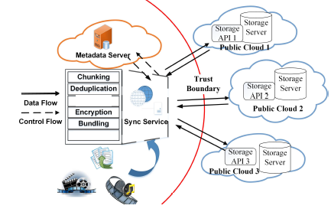
Simple Project Flow

Slide 8
Technology Stack
Operating system : Windows 7.
Coding Language : Java/J2EE.
Tool : Netbeans 7.4
Designing : Html, CSS
Data Base : MySQL.

Slide 9
References
M. Balazinska, B. Howe, and D. Suciu, “Data markets in the cloud: An opportunity for the database community,” PVLDB, vol. 4, no. 12, pp. 1482–1485, 2011.
Bessani, M. Correia, B. Quaresma, F. Andr´e, and P. Sousa, “Depsky: dependable and secure storage in a cloud-of-clouds,” ACM Transactions on Storage (TOS), vol. 9, no. 4, p. 12, 2013.
H. Chen, Y. Hu, P. Lee, and Y. Tang, “Nccloud: A network-coding-based storage system in a cloud-of-clouds,” 2013.

Slide 10
Thank You

Slide 11
Any Queries….???

